Slide 1
Lecture 04 - Component Segmentation
Prof. André Gustavo Hochuli
gustavo.hochuli@pucpr.br
aghochuli@ppgia.pucpr.br
Notes:
Prof. André Hochuli

Slide 2
Topics
Discussion of Practice 03
Component Segmentation
Find Connected Components
Watershed
Filtering Components
Practice
Coin Segmentation
Computer Vision - Prof. André Hochuli
Lecture 04
Notes:
Prof. André Hochuli

Slide 3
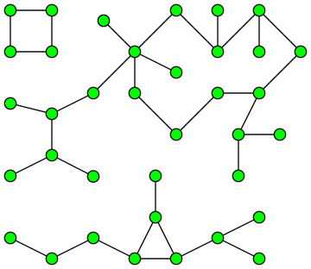
Component Segmentation
A.K.A Connected Component Extraction, Blob Extraction, …..
Its application comes from Graph Theory
Computer Vision - Prof. André Hochuli
Lecture 04
Notes:
Prof. André Hochuli

Slide 4
Row by Row Algorithm
A.K.A Connected Component Extraction, Blob Extraction, …..
Its application comes from Graph Theory
Computer Vision - Prof. André Hochuli
Lecture 04
Notes:
Prof. André Hochuli

